Slide 1
Real-time sign language recognition system based on YOLO
SHU WANYANG
YAN JIAHUAN
XIAO CHANGWEI

Slide 2
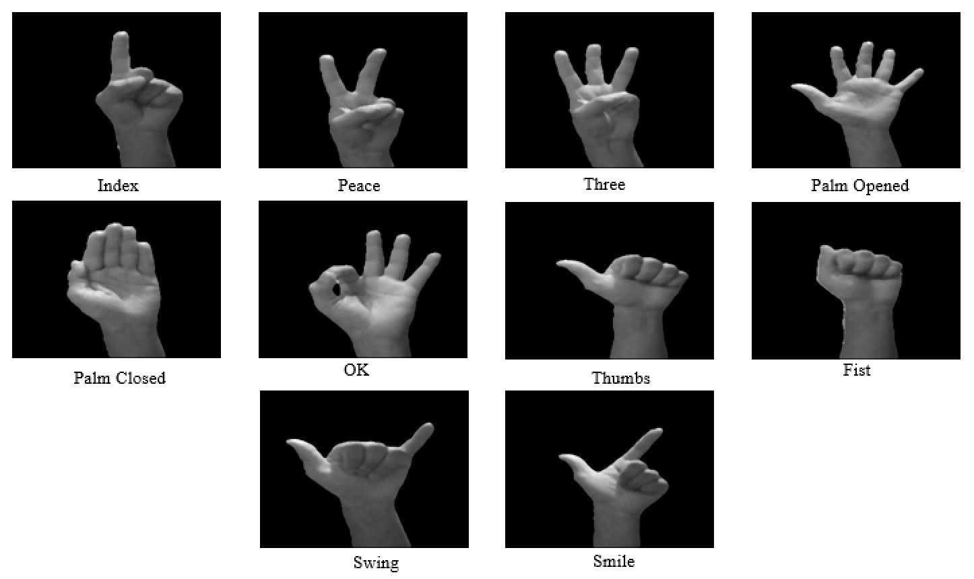
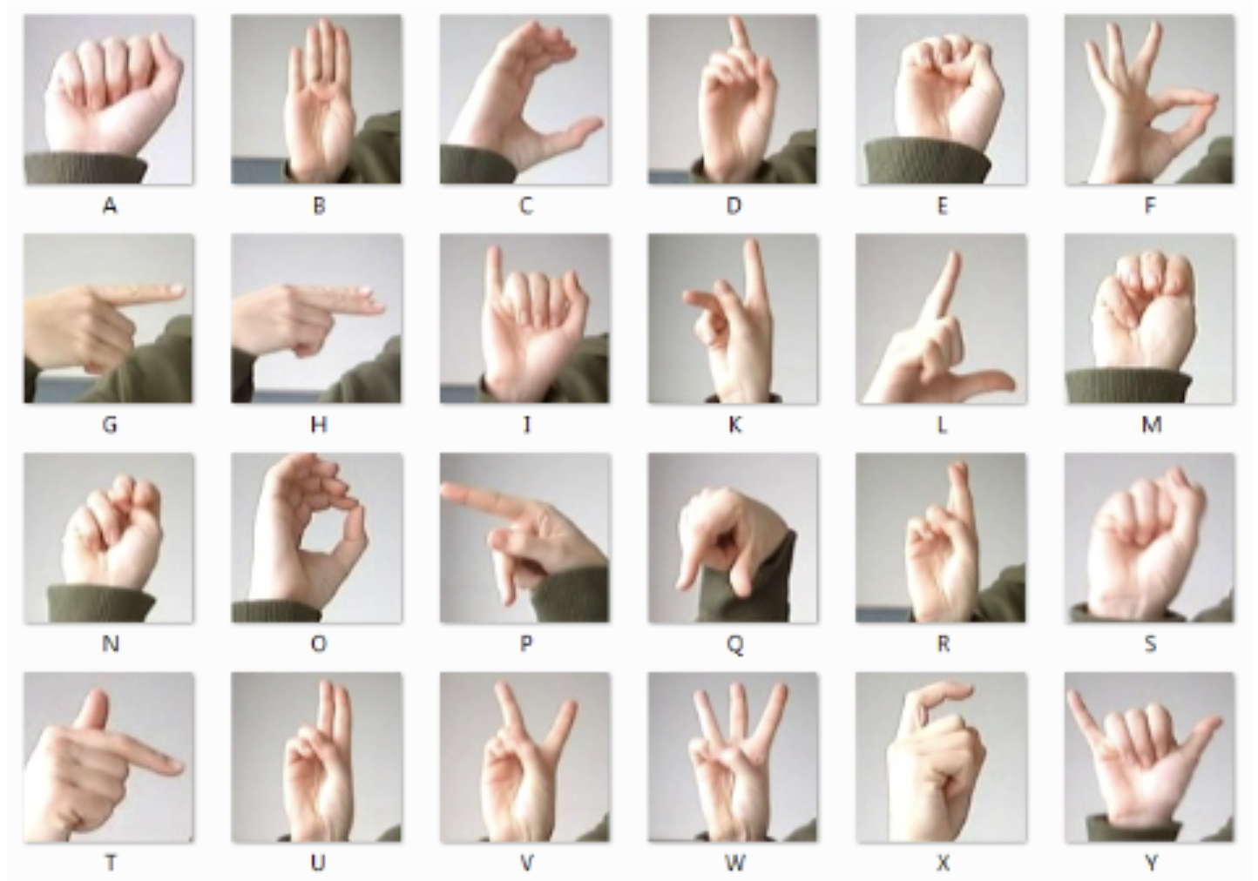
Introduction
Single Word
Single Letter

Slide 3
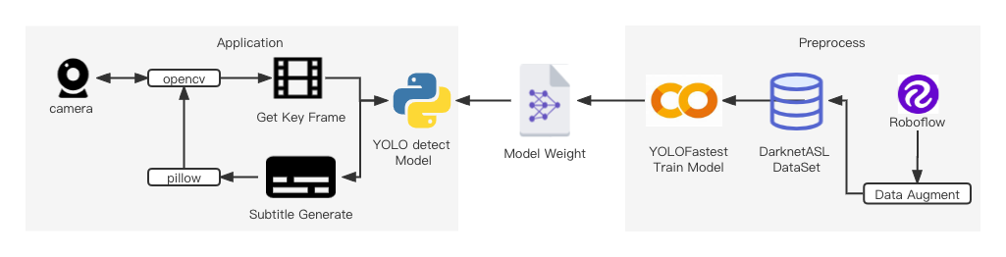
Overall Architecture

Slide 4
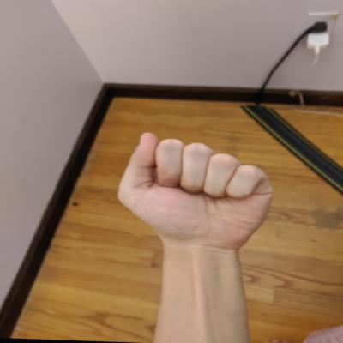

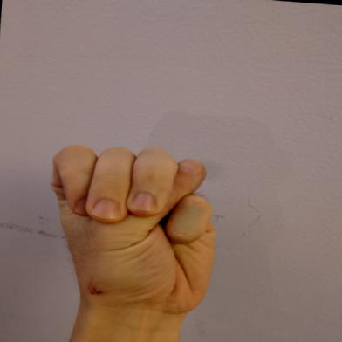
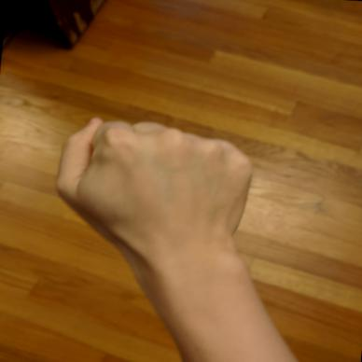
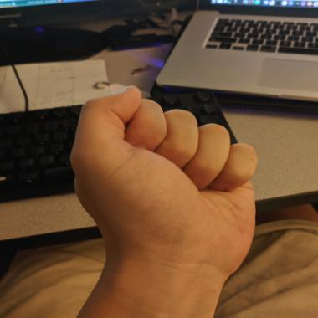
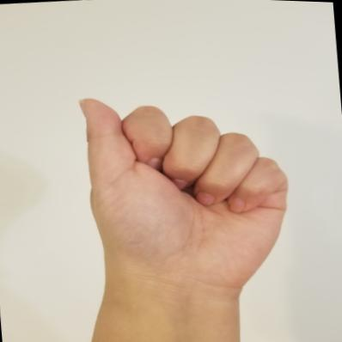
Dataset Preparation
Both ‘A’
Some of the samples are too similar.
Data imbalance.
Defects！
Original Dataset:
Total of 1728 images collected by David Lee from roboflow [1].
This is ‘M’
Almost 1:3
Still ‘A’
[1] American Sign Language Letters Dataset (roboflow.com)

Slide 5
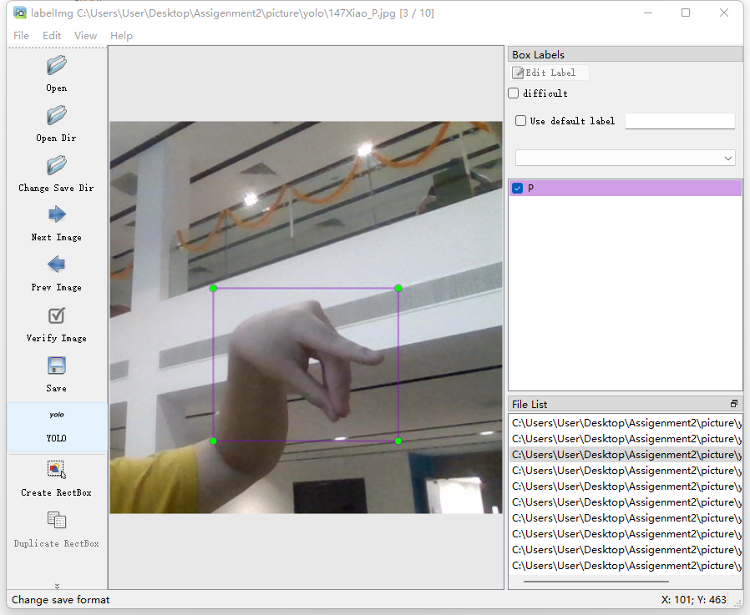
Dataset Preparation
V1
V2
Self-collected data
Python = 3.8
Pip install lebelimg
Counteract the imbalance and improve generalization capabilities
Original Dataset
New Dataset
Label:
15
0.5096153846153846 0.5432692307692307 0.8076923076923077 0.8076923076923077
We collected another 500 more data!
(x,y)
(w,h)

Slide 6
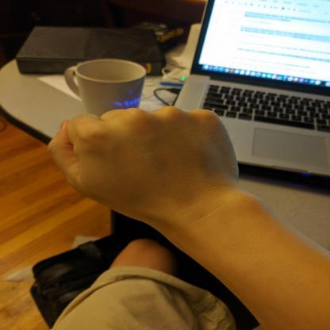
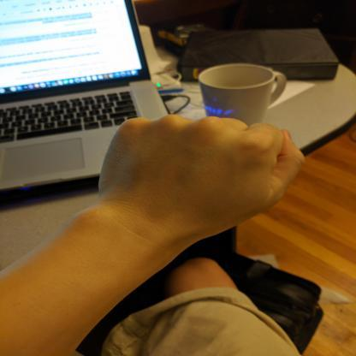
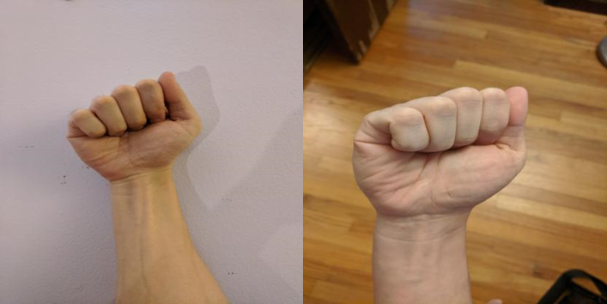

Data augmentation
Origin
Rotation, zoom, mirror
Gaussian noise

Slide 7
Data pre-processing
cv.resize()
Resize to 416x416
Origin
After

Slide 8
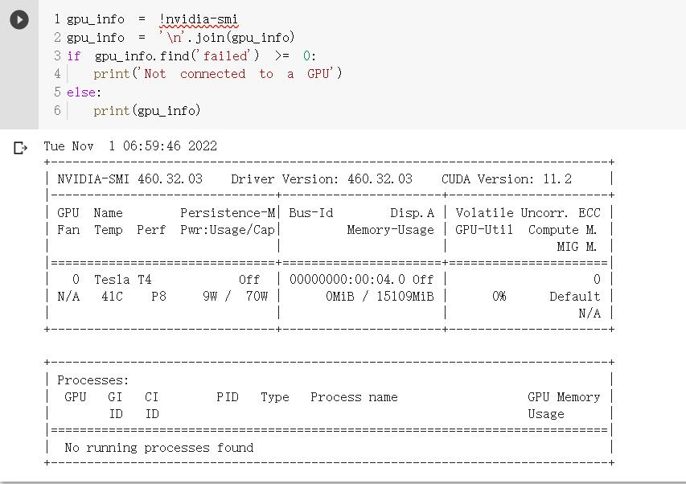
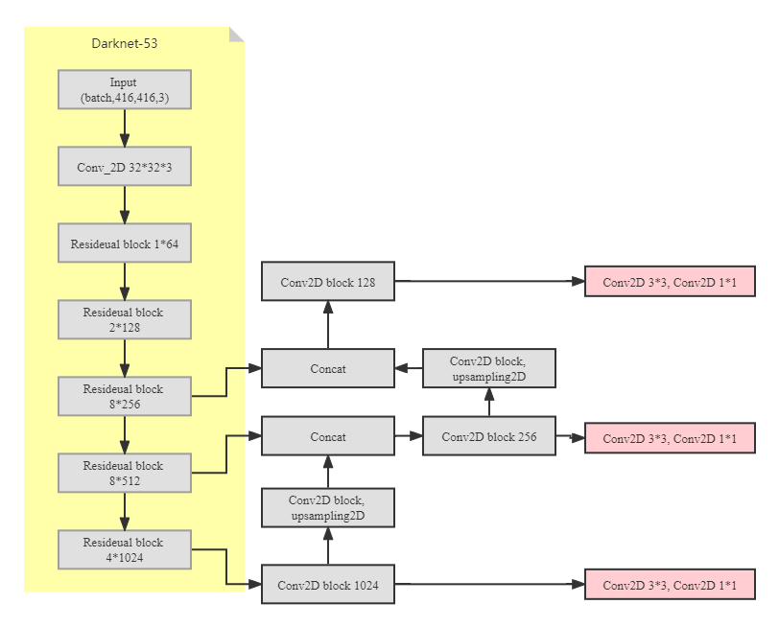

Network based on YOLOv3
We trained our model on Colab.
High ram!
Tesla T4 GPU!
Pro+!
The training time varies from 3 hours to 8 hours according to the setup of batch size and epoch number (won’t improve after 200 epochs)
We build the network architecture basically based on Darknet-53.

Slide 9
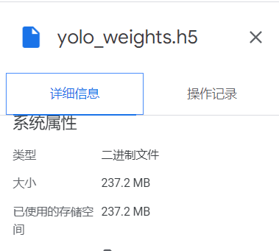
Network based on YOLOv3
Too large
Our system can only operate at a low speed.
The FPS is reduced to 1~3.
We decided to narrow our model down to 10MB.

Slide 10
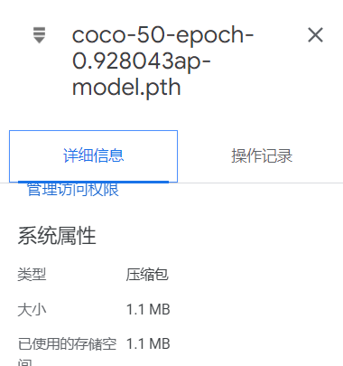


Network based on YOLOv3
--original model
Total params: 61,581,727
Trainable params: 61,529,119
Non-trainable params: 52,608
--lightweight model
Total params: 242,146
Trainable params: 242,146
Non-trainable params: 0
We also used a non-backpropagation method to update the BN parameters to speed up the training.

Slide 11
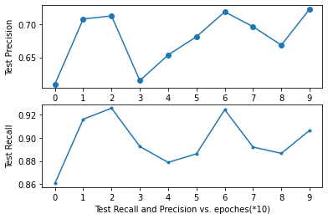
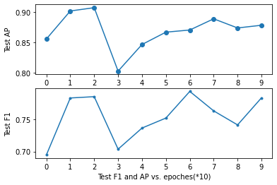

The hyperparameters during training
Epoch: 200
Steps: [150,250]
Batch size: 8
Learning rate: start from 1e-3, decreased to 1e-4 according to Adam optimizer
Anchors: [120.55, 97.22, 148.54, 151.12, 185.12, 214.38, 228.47, 147.84, 259.63, 210.48, 268.54, 291.81]
Class: 26
The best average precision is about 0.92

Slide 12
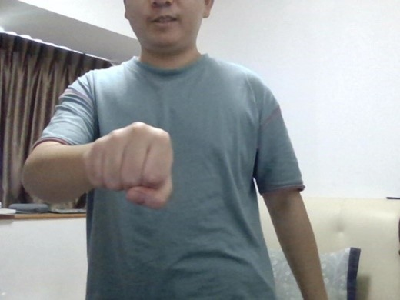
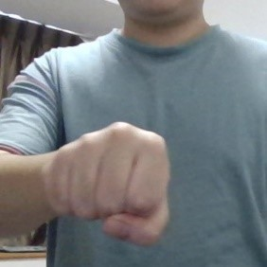
Get Key Frame
Mediapipe
Before Screenshot
After Screenshot
Notes:
Now we have the model, but the picture we got from the camera doesn't apply. Because the hand is only part of the image, the whole image contains a lot of useless information, such as the person’s face, arms, upper body and so on.

Slide 13
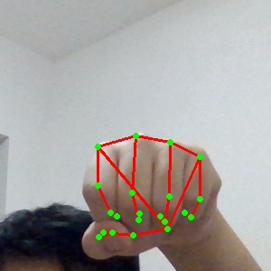
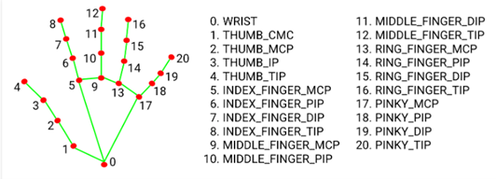
Get Key Frame
Middle_Finger_Mcp
Notes:
MediaPipe can provide us with their specific coordinates through the recognition of 21 joints in the hand, to locate the hand position. We built a 416x416 resolution screenshot using the node closest to the center of the hand, the node # 9. Once we finally have a valid screenshot, we can transfer it to the model to get the results we want.

Slide 14
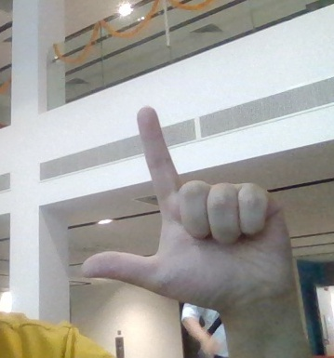
Subtitle Generate
1st time
L
2nd time
L
Sign language recognition system
Input
Get Label
3rd time
L
Text.append(“L”)
4th time
L
5th time
L
Key Frame
Notes:
Finally, how does the system tell us what it recognizes? We need to generate subtitles. First, we need to make sure that the gestures the system recognizes are stable and reliable. The system gives a judgment for each frame of the hand image, and when the judgment is consistent five times in a row, the letter is added to the "text" list.

Slide 15
Subtitle Generate
Text=[“W”,”E”,”L”,”C”,”O”,”M”,”E”,”T”,”O”,”N”,”U”,”S”]
Wordninja
“WELCOME TO NUS”
Notes:
Now we have a list of text, but each letter in it is still separate. This is where step two comes in, Use Wordninja to participle the text. wordninja is a third-party library for word segmentation of consecutive English strings. The word segmentation of wordninja is based on the frequency of Wikipedia corpus. In English language, it is reasonably believed that the distribution follows Ziv's law, and the word bank is established from the highest to the bottom according to the occurrence probability, so as to achieve the purpose of word segmentation.

Slide 16
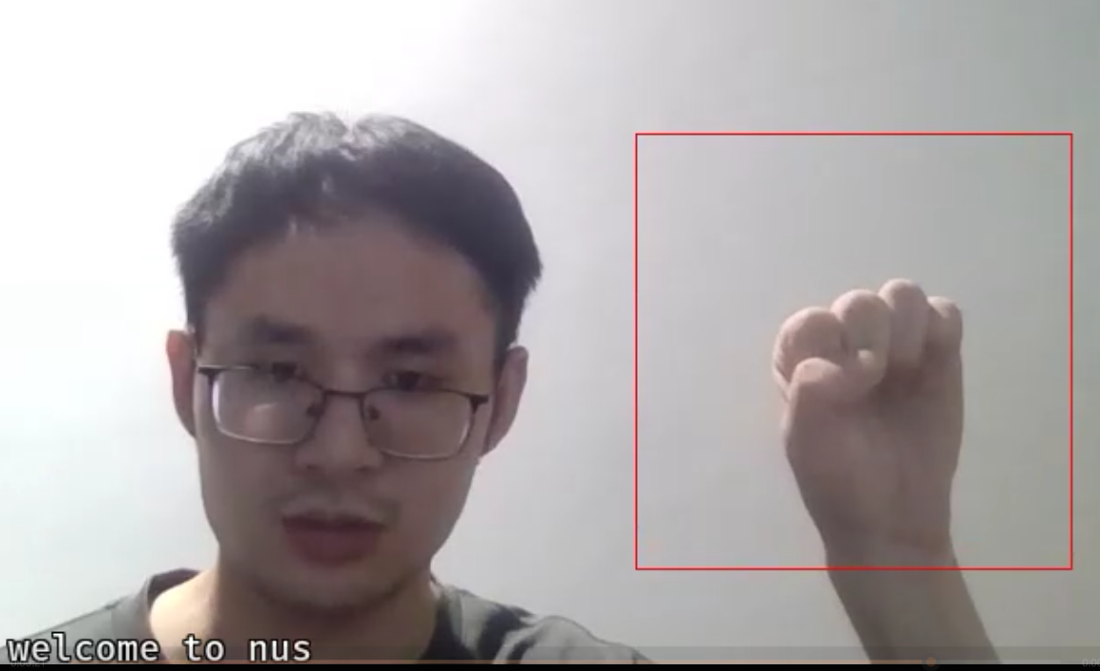
Subtitle Generate
“WEICOME TO NUS”
Pyspellchecker
“WELCOME TO NUS”
PIL
Notes:
In the third step we will make sure the words are spelled correctly. Even though we ensured the reliability and stability of the results in the first step, the non-standard use of sign language may lead to incorrect spelling. Here we use the pyspellchecker library to help us. It will correct our spelling mistakes. Finally, we just use the Python Image Library print the content to our screen.

Slide 17
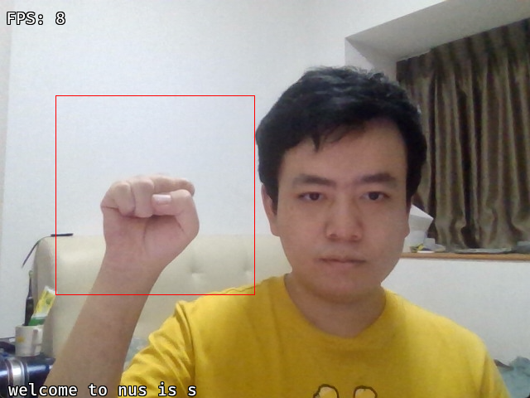
Limitation
Unreasonable Spellcheck
Incorrect Spellcheck!

Slide 18
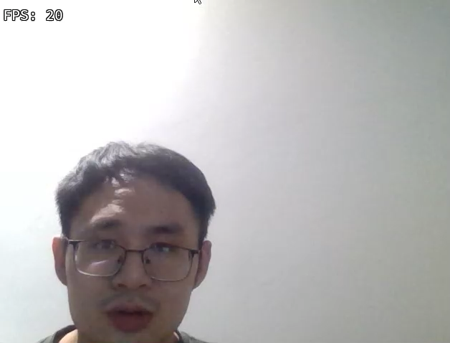
Use Demo

Slide 19
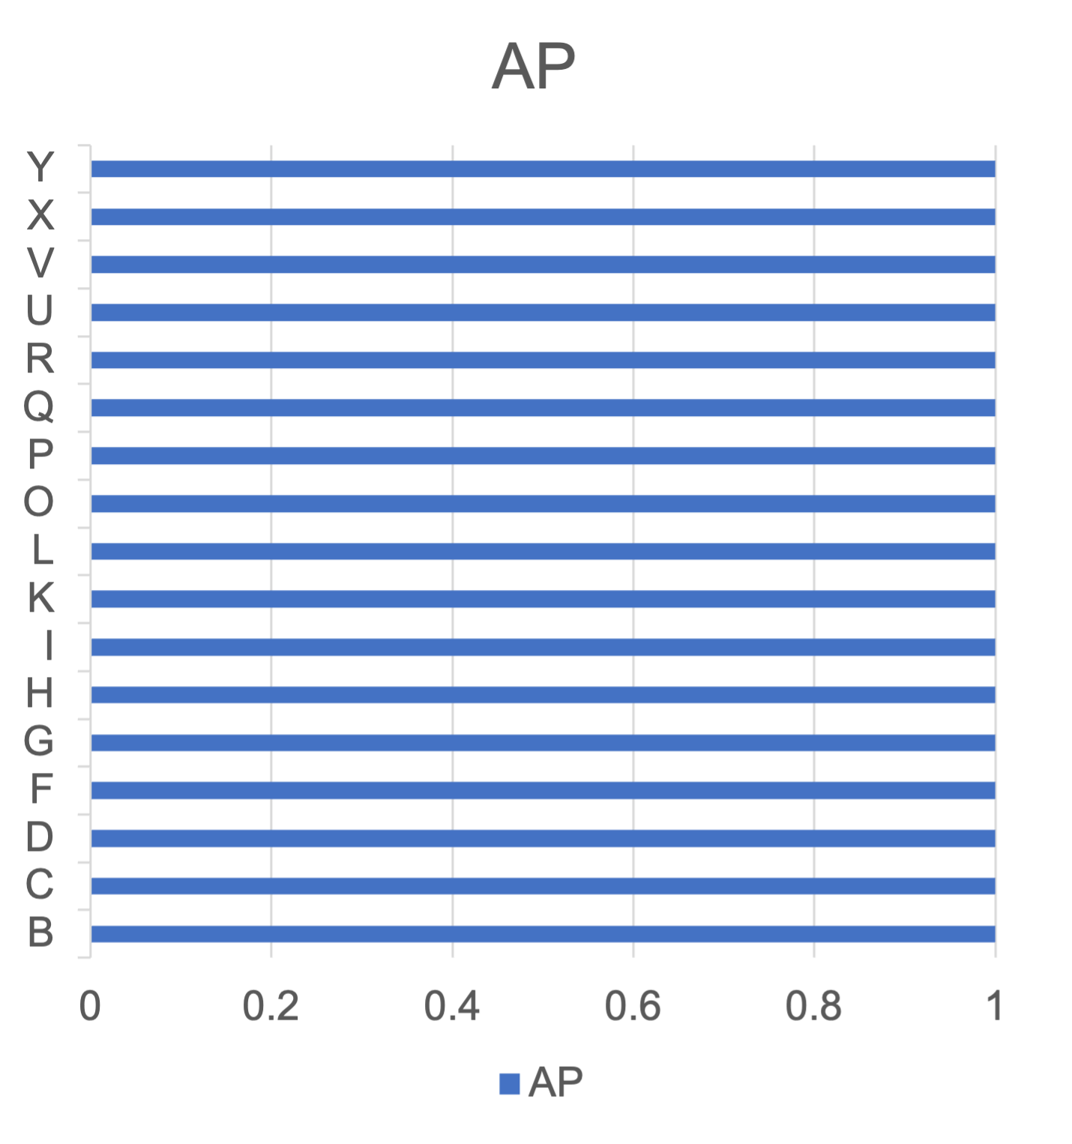
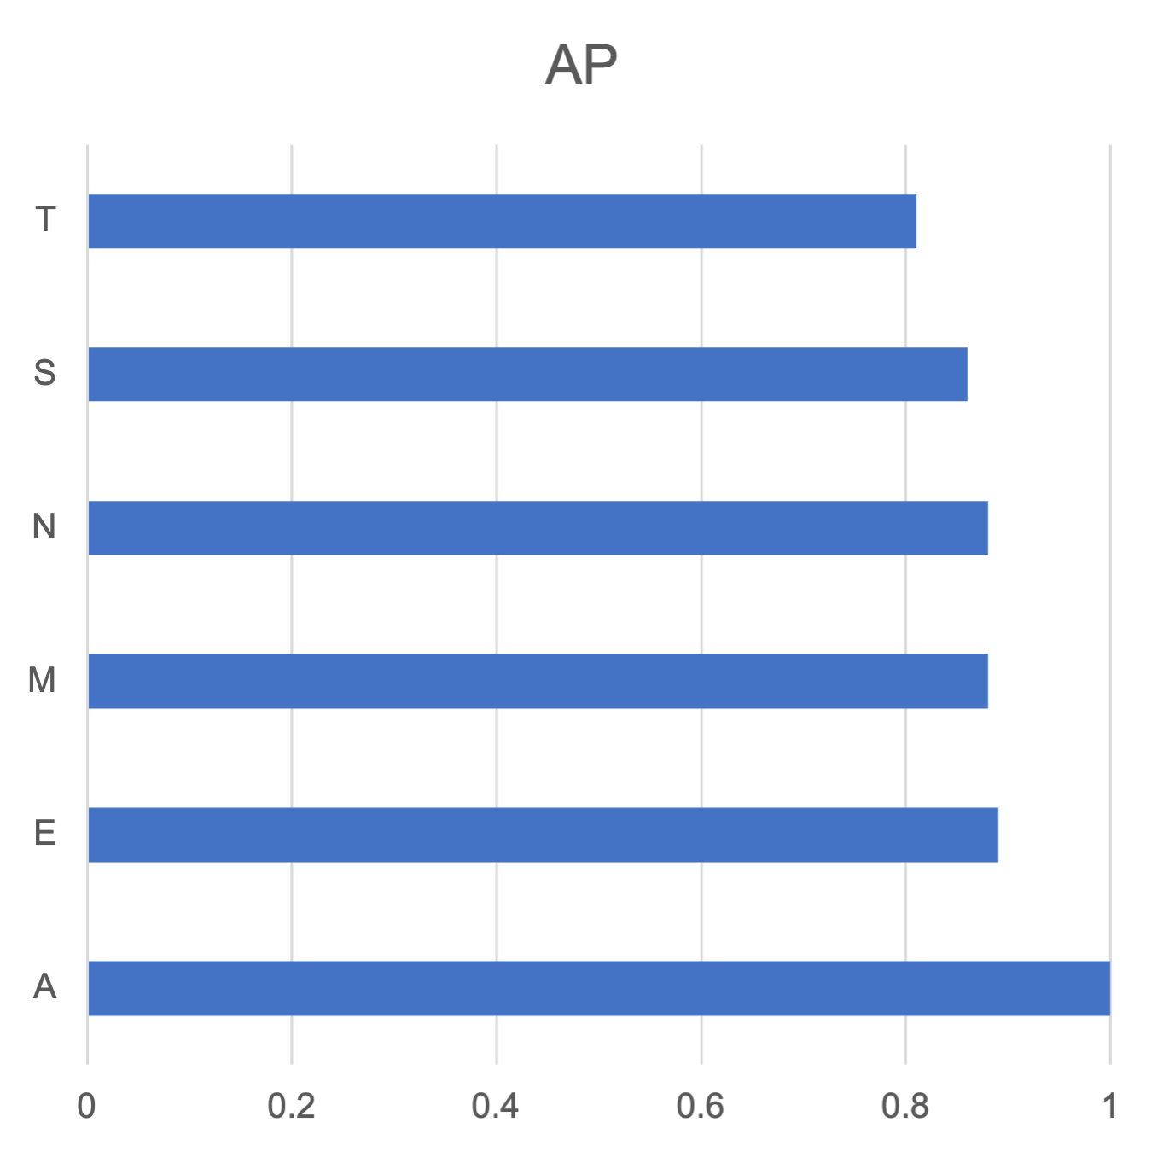
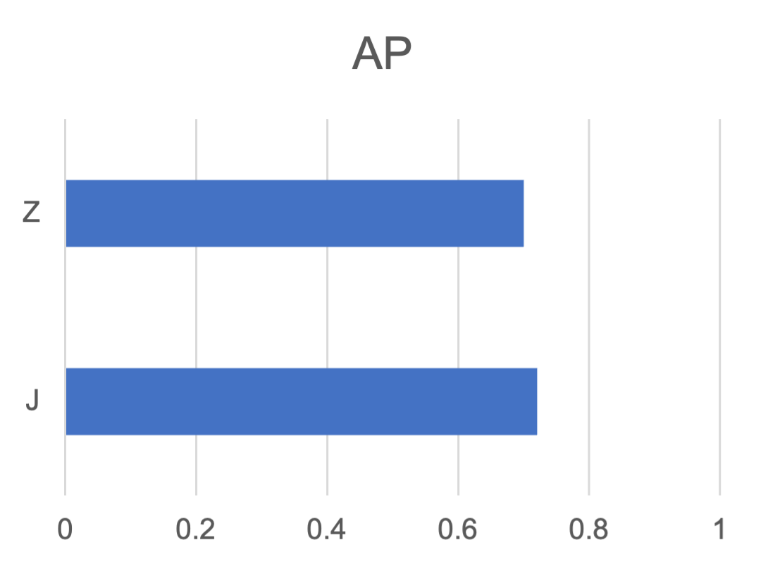
Evaluation
Accuracy of each letter – Average Precision
Easy to identify and classify
Easy to classify
Easy to identify

Slide 20
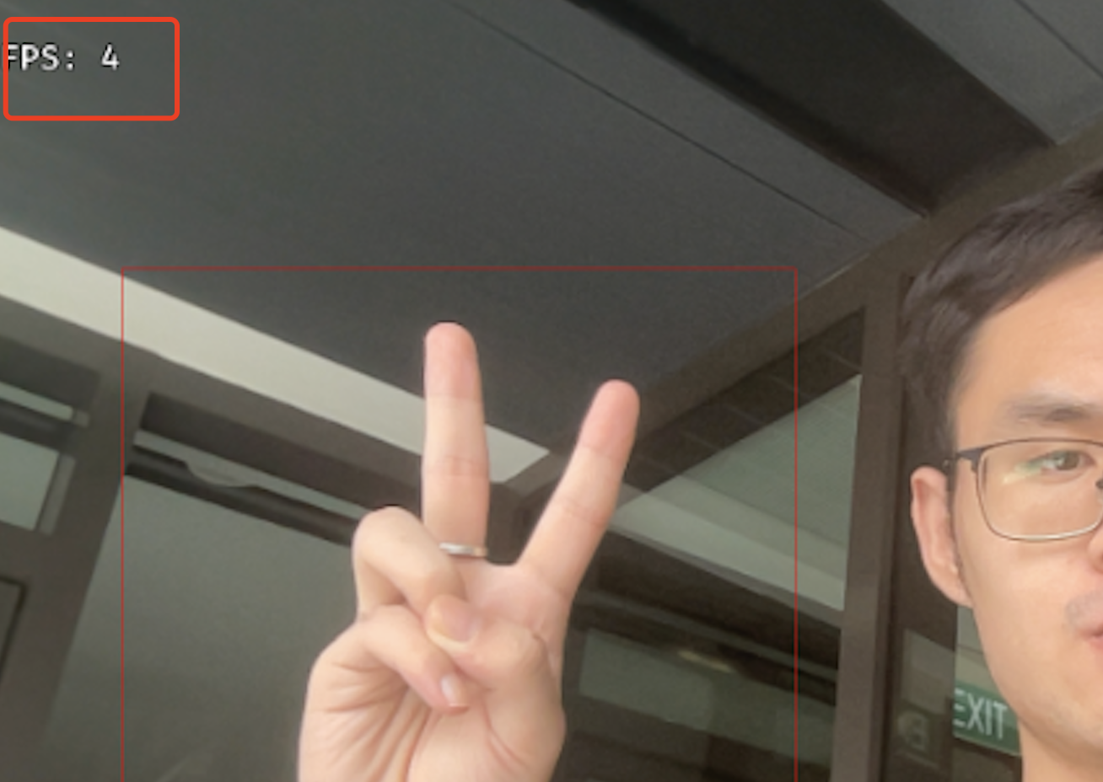
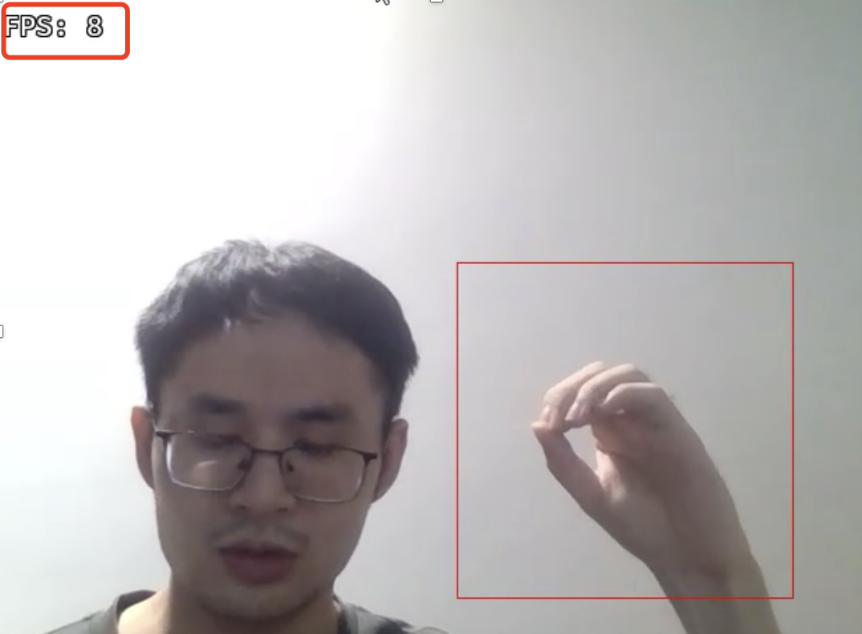
Limitation
Response time – FPS
fps = 1 / (new_frame_time - prev_frame_time)

Slide 21

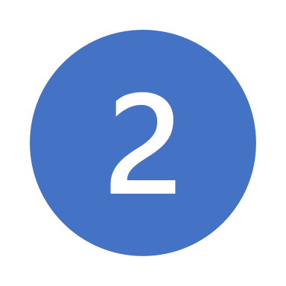
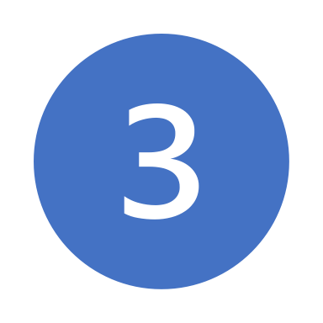
Improving Work
Adopt Better dataset to improving the classification of hard classified and identified Letters
Adopt Better deployment method to shorter the delay of YOLO detect module
Adopt NLP to improve the rationality of generated Translation

